Slide 1
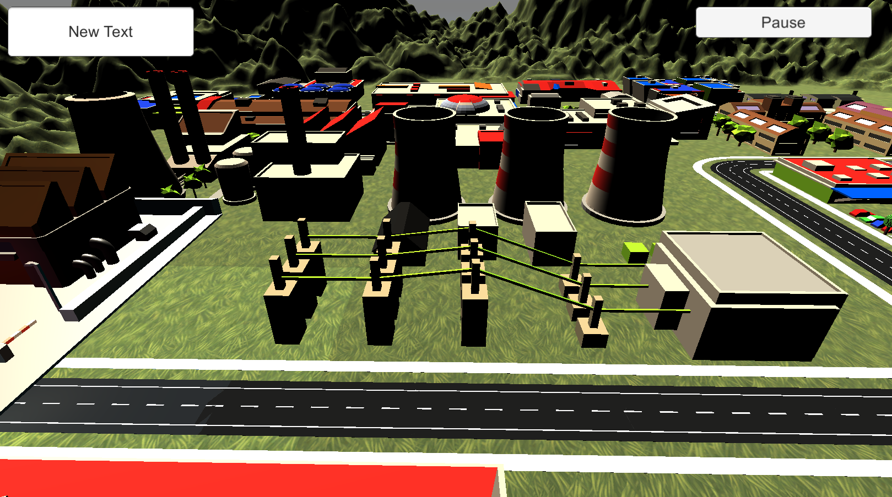
Player: Sam Score: 500
Multiple choice
Odd one out
Correct order
Random

